Slide 1
AI-Powered Multi-Violation Traffic Monitoring via Real-Time Computer Vision

Slide 2
Contents
• Abstract
• Objective of Project
• Problem Statement
• Scope and Motivation
• Introduction
• Literature Review
• Existing Methods
• Disadvantages
• Proposed Method
• Block Diagram
• Advantages
• Project Flow
• Applications
• Software & Hardware Requirement
Modules
UML Diagram
Output Screens
Conclusion
Future Enhancement
References

Slide 3
Abstract
This project proposes a deep learning-based system to detect traffic violations, including not wearing a helmet, triple riding, phone usage while riding, and wheeling, using YOLOv8 and YOLOv11 (You Only Look Once versions 8 and 11). The system leverages the advanced object detection capabilities of both YOLOv8 and YOLOv11 to identify and classify these violations in real-time from video feeds, ensuring enhanced road safety. The application aims to improve traffic law enforcement by automatically detecting dangerous behaviors, providing a reliable solution for monitoring and preventing accidents.
Keywords: YOLOv8, YOLOv11, helmet violation, triple riding, phone usage detection, wheeling, deep learning, object detection, traffic safety, real-time monitoring.

Slide 4
Objective of the project
The primary goal of this project is to develop an automated system for detecting traffic violations through advanced deep learning models, specifically YOLOv8 and YOLOv11. This system will be capable of detecting and classifying a range of traffic violations, including not wearing helmets, triple riding, phone usage while riding, and wheeling. The project will involve the development of a Python-based backend to process real-time video feeds, ensuring efficient detection of violations as they occur. Additionally, a user-friendly front-end interface will be designed using Streamlit, enabling traffic authorities to easily visualize the results of the detection system and interact with the data. Ultimately, the system aims to improve road safety by providing a reliable, automated solution for real-time traffic violation detection, making the process faster, more accurate, and scalable.

Slide 5
Problem Statement
Manual monitoring of traffic violations is a labor-intensive process with inconsistent results and limited scalability. With the increasing number of vehicles on the road, traditional methods struggle to effectively detect multiple violations simultaneously. This project aims to address these limitations by utilizing the advanced capabilities of YOLOv8 and YOLOv11 models for object detection. These models will enable automated, real-time detection of violations such as not wearing a helmet, triple riding, and distracted driving, offering an accurate, scalable, and efficient solution for traffic law enforcement.

Slide 6
Scope
This project will involve:
Collecting and preprocessing datasets containing various instances of helmet violations, triple riding, phone usage, and wheeling for training both YOLOv8 and YOLOv11.
Training and fine-tuning these models to achieve high detection accuracy for the specified traffic violations.
Deploying the trained models with a Python-based backend that processes video feeds in real-time.
Building an interactive front-end with Streamlit to display real-time results of traffic violation detection.
Evaluating the system’s performance in terms of accuracy, speed, and scalability to ensure that it can be deployed in real-world traffic monitoring environments.

Slide 7
Motivation
Ensuring the safety of riders by detecting violations such as not wearing helmets, triple riding, using a phone while riding, and performing wheelies is vital for road safety. Traditional traffic law enforcement methods rely heavily on human observation, which is slow, error-prone, and inefficient. The motivation behind this project is to leverage the power of deep learning models like YOLOv8 and YOLOv11 to automate the detection of these dangerous traffic violations. The goal is to improve road safety by reducing accidents and enhancing the efficiency of traffic enforcement using state-of-the-art object detection algorithms.

Slide 8
Introduction
This project introduces a deep learning-based solution for detecting traffic violations, leveraging the powerful object detection capabilities of YOLOv8 and YOLOv11. These models can efficiently identify violations such as helmet non-compliance, triple riding, phone usage while riding, and wheeling in video footage captured by traffic cameras. The integration of a Python-based backend and a Streamlit front-end ensures seamless interaction and visualization for traffic authorities. By automating the detection process, the system aims to reduce human errors, improve enforcement efficiency, and ultimately enhance road safety.

Slide 9
Literature Survey
Year | Ref | Authors | Algorithms | Datasets | Result | Remarks
2023 | [11] | R. G. Nandhakumar et al. | YOLOv3, OCR | Self-generated | 95.5% | Focused on traffic rule violator’s number plate detection. Model unable to detect and extract fancy number plate.
2023 | [21] | S. Venkatramulu et al. | CNN | Self-generated | NA | Accuracy of the model is not clearly defined.
2023 | [14] | Q. An et al. | YOLOv5s-improved | Safety helmet wearing + SHWD dataset | 92.4% | Focused only on helmet and no helmet detection, other traffic rule violations not covered.
2022 | [16] | Tasbeeha Waris et al. | Faster R-CNN | Self-generated | 97.6% | System not trained to detect other traffic rule violations such as triple riding, wrong number plate detection.

Slide 10
Literature Survey
2022 | [22] | R. S. Charran et al. | YOLOv4 + DeepSORT / Tesseract | Self-generated + Kaggle (Number Plate) | 98.0% | Multiple violation detection system developed but used separate class labels for helmet and triple riding detection.
2021 | [17] | Mallela et al. | YOLOv3, GSM | MS COCO datasets | 91.7% | System not trained to detect other traffic rule violations such as triple riding, wrong number plate detection.
2020 | [15] | H. Lin et al. | CNN based MTL | HELMET datasets | 67.3% | Frame-based motorcycle detection system achieved 95.3% accuracy in identifying motorcycles and 67.3% score in effectively counting riders and checking helmet usage.
2020 | [6] | A. Tonge et al. | CNN, mask RCNN | Self-generated | 87% | Accuracy is low, can be improved by including negative data samples.
2016 | [12] | K. Dahiya et al. | HOG, SHIFT, LBP | Self-generated | 93.8% | Implementation of preprocessing techniques makes the process slow.

Slide 11
Existing Methods
Currently, traffic violations such as not wearing helmets, triple riding, phone usage while riding, and wheeling are primarily detected using manual monitoring methods or traditional image processing techniques. These systems typically rely on human inspectors or rule-based algorithms to visually check for violations. Some advanced systems use object detection techniques like YOLOv3 or YOLOv4, but they often focus on one violation at a time, such as helmet detection, and lack the capability to detect multiple violations simultaneously. While newer systems like YOLOv8 and YOLOv11 can handle more complex tasks, many existing systems are still limited by low accuracy, inefficiency, and their inability to scale for real-time, large-scale traffic monitoring.

Slide 12
Existing Methods
Limited Accuracy: Existing systems often suffer from inaccurate detection due to poor handling of complex scenarios like fancy or modified number plates, overlapping objects, and false positives.
Lack of Scalability: Traditional monitoring systems struggle to process large-scale, real-time data from numerous cameras deployed across cities, limiting their effectiveness in dynamic traffic environments.
Single Violation Detection: Many systems can only detect one specific traffic violation at a time, such as helmet usage, while missing out on detecting multiple violations like triple riding and phone usage simultaneously.
Manual Monitoring: Systems that rely on human inspectors are prone to fatigue, errors, and inconsistent detection, which can lead to missed violations.
Slow Processing: Some older systems are slow due to reliance on manual steps or traditional image processing techniques, making them unsuitable for real-time applications.

Slide 13
Proposed Methods
The proposed system employs deep learning techniques, specifically the YOLOv8 and YOLOv11 object detection models, to simultaneously detect multiple traffic violations in real-time. YOLOv8 and YOLOv11 are advanced object detection algorithms capable of handling various violations, such as:
Helmet Violation: Detecting if a rider is wearing a helmet.
Triple Riding: Identifying if more than two individuals are riding on a motorcycle.
Phone Usage: Detecting if a rider is using a phone while driving.
Wheeling: Detecting the act of lifting the front wheel of the motorcycle off the ground, which is considered a dangerous behavior.

Slide 14
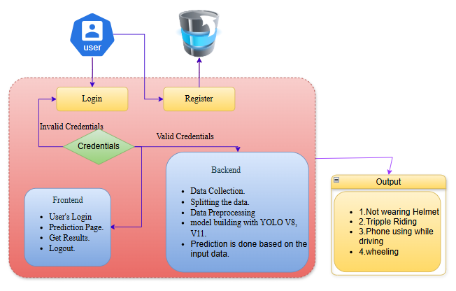
Block Diagram

Slide 15
Proposed Methods
High Accuracy: YOLOv8 and YOLOv11 provide high precision and recall, ensuring accurate detection of traffic violations, even in complex or crowded scenarios.
Real-Time Processing: The system is capable of providing real-time violation detection, enabling immediate action to be taken by traffic authorities.
Multi-Violation Detection: Unlike traditional systems, this solution can detect multiple traffic violations (e.g., helmet use, triple riding, phone usage, and wheeling) simultaneously, providing a comprehensive monitoring solution.
Scalable: The system can scale to accommodate large datasets and multiple cameras, making it ideal for deployment in busy urban areas with high traffic volumes.

Slide 16
Proposed Methods
Reduced Human Error: Automating the detection process reduces dependence on human inspectors, thereby minimizing errors and ensuring consistent detection across all cameras.
Cost-Effective: By automating traffic law enforcement, the system reduces the need for manual labor, which lowers operational costs and increases the efficiency of law enforcement.
User-Friendly Interface: The front-end interface developed with Streamlit provides an intuitive and accessible platform for traffic authorities to interact with, making it easy for non-technical users to visualize and manage violation detections.

Slide 17
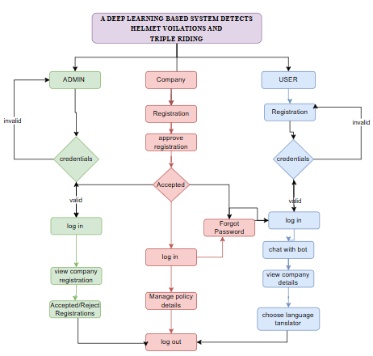
Project Flow

Slide 18
Applications
Applications of the Project
The Passenger Flow Prediction System for mass events has a wide range of applications, particularly in the areas of event management, crowd control, and resource allocation. Here are some key applications of the project:
Event Management:
  The system can assist organizers of large-scale events (such as concerts, sports games, festivals, and conferences) by predicting passenger inflow and outflow. This helps optimize the logistics of the event, ensuring that transportation and facilities can handle the crowd size efficiently.
Crowd Control and Safety:
  By accurately forecasting crowd movement, the system can help event organizers implement appropriate crowd control measures, ensuring the safety of attendees. For example, predicting areas of congestion or peak times allows organizers to deploy additional security personnel or adjust crowd flow strategies to prevent accidents.

Slide 19
Applications
Transportation Planning:
The predictions for inflow and outflow can be used to optimize transportation schedules (e.g., buses, shuttles, or trains) before, during, and after an event. This reduces wait times, minimizes congestion, and ensures that transportation is adequately available to accommodate the predicted crowd.
Resource Allocation:
Based on the predicted crowd sizes at different times, the system can help allocate resources (such as staff, food, water, and first aid services) more effectively. For example, if a high inflow is predicted, the system can trigger the need for more staff at entrances or food stalls.
Real-Time Event Adjustment:
The system's ability to provide real-time predictions based on incoming data (such as weather, transportation delays, or crowd behavior) allows event organizers to make immediate adjustments. For example, if unexpected weather conditions cause delays, the system can adjust the inflow and outflow predictions to reflect these changes.

Slide 20
Software & Hardware Requirement
Hardware Requirements
Processor: Intel i3 or equivalent for handling basic video processing.
RAM: 8 GB for smooth operation.
Storage: 160 GB hard disk.
Cameras:
  High-definition CCTV cameras (1080p or higher resolution).
  Frame rate: Minimum 30 frames per second (FPS).
GPU: None specified, but NVIDIA GTX 1080 or higher is recommended for faster inference in deep learning tasks.
Network: High-speed internet connection (minimum 1 Gbps) for smooth data transfer.

Slide 21
Software & Hardware Requirement
Operating System:
  Windows 7/8/10 for the front-end development.
  Linux-based OS (Ubuntu 18.04 or higher) for backend deployment.
Server-side Script: HTML, CSS, Bootstrap, and JS.
Programming Languages:
  Python (for backend and model training).
  JavaScript, HTML, CSS (for front-end development via Streamlit).
Deep Learning Frameworks:
  TensorFlow or PyTorch (for YOLOv8 , v11 model implementation).
  OpenCV (for video processing and frame extraction).
Libraries and Tools:
  Streamlit (for the front-end interface).
  Flask (for API integration between backend and front-end).
  NumPy, Pandas (for data processing and analysis).

Slide 22
Software & Hardware Requirement
Operating System
  Windows / Linux (Ubuntu preferred)
  Purpose: Environment for running models and managing data.
Programming Languages
  Python, SQL
  Purpose: Implement models, data preprocessing, and manage databases.
Deep Learning Frameworks:
  TensorFlow or PyTorch (for YOLOv8, v11, model implementation).
  OpenCV (for video processing and frame extraction).
  .
Database
  MySQL / PostgreSQL
  Purpose: Store event data and predictions.

Slide 23
Software & Hardware Requirement
Libraries and Tools:
  Streamlit (for the front-end interface).
  Flask (for API integration between backend and front-end).
  NumPy, Pandas (for data processing and analysis).
Database: MySQL or PostgreSQL (for storing logs and metadata of violations).
IDE/Workbench: PyCharm or VSCode for Python development.
Server Deployment: XAMPP Server.

Slide 24
Modules
System Overview
Data Collection: The dataset of stroke images is divided into two subsets: 80% for training and 20% for testing.
Data Splitting: The dataset is split into two parts – one for model training and the other for testing.
Model Training: 80% of the data is used to train the model, fine-tuning its parameters to minimize errors using optimization techniques like gradient descent.
Model Testing: The remaining 20% is used to test the model’s accuracy in predicting stroke lesion segmentation.
Model Saving: After training, the model is saved in a .pt format to preserve its learned weights.
Model Prediction: New images are input into the trained model to predict stroke lesions.

Slide 25
Modules
User:
Register: Users should first register with their credentials to create an account in the system.
Login: Users can log in with their registered credentials to access the system.
Upload Data: Users can upload their images to predict whether it is stroke or normal.
Viewing Results: That uploaded image will going to the model part to predict and it will give the prediction and user can view the result.
Logout: Finally, users can log out of the system to secure their session and personal data.

Slide 26
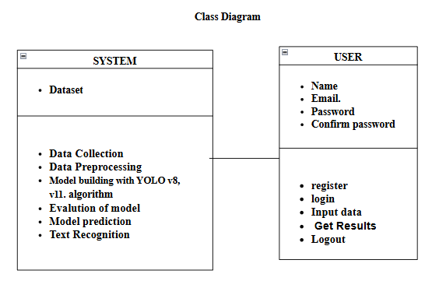
UML
Class diagram

Slide 27
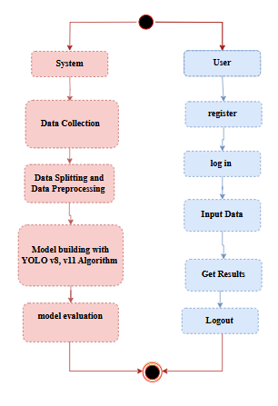
UML
Activity Diagram

Slide 28
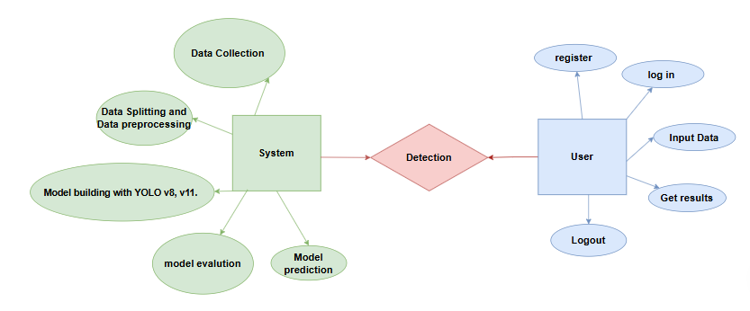
UML
ER Diagram

Slide 29
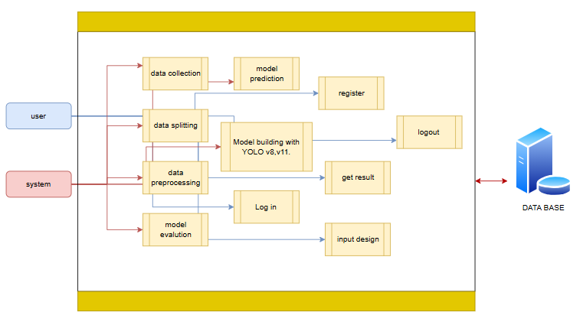
UML
Sequence Diagram
Level 1:

Slide 30
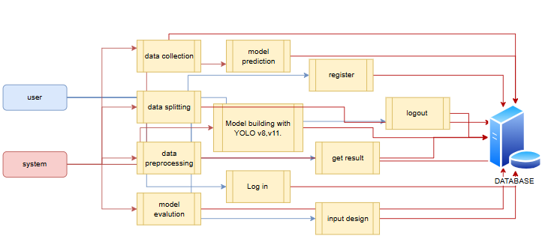
UML
Sequence Diagram
Level 2:

Slide 31
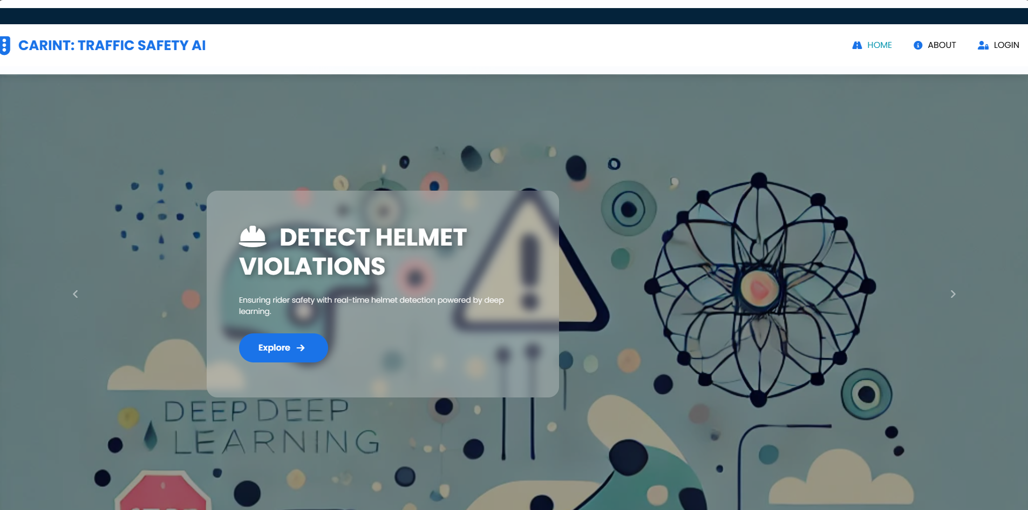
Screen shots
HOME PAGE

Slide 32
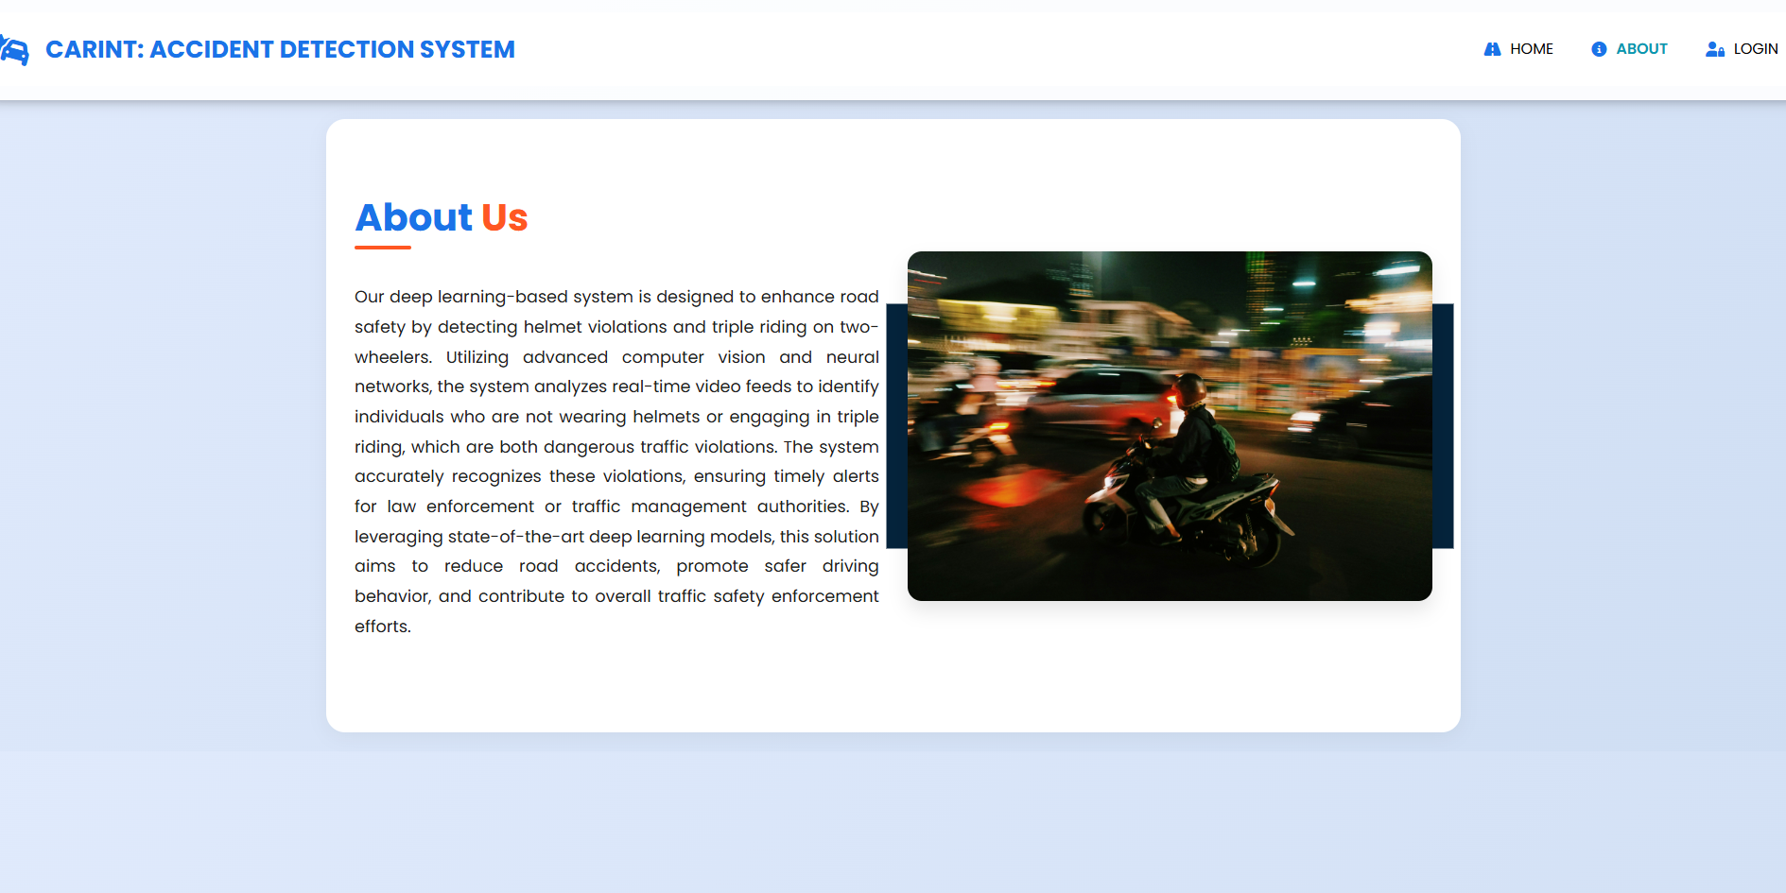
Screen shots
ABOUT PAGE :

Slide 33
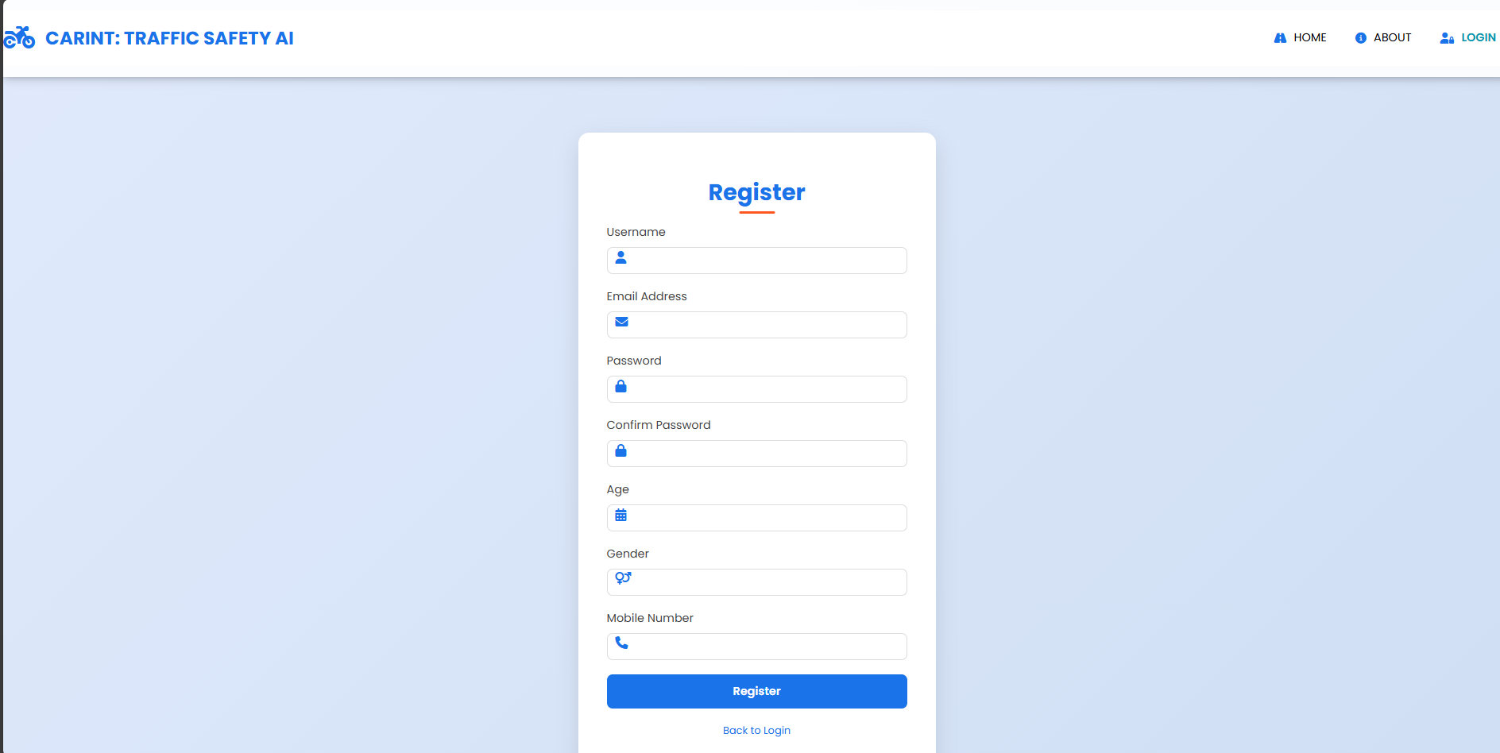
Screen shots
Register Page

Slide 34
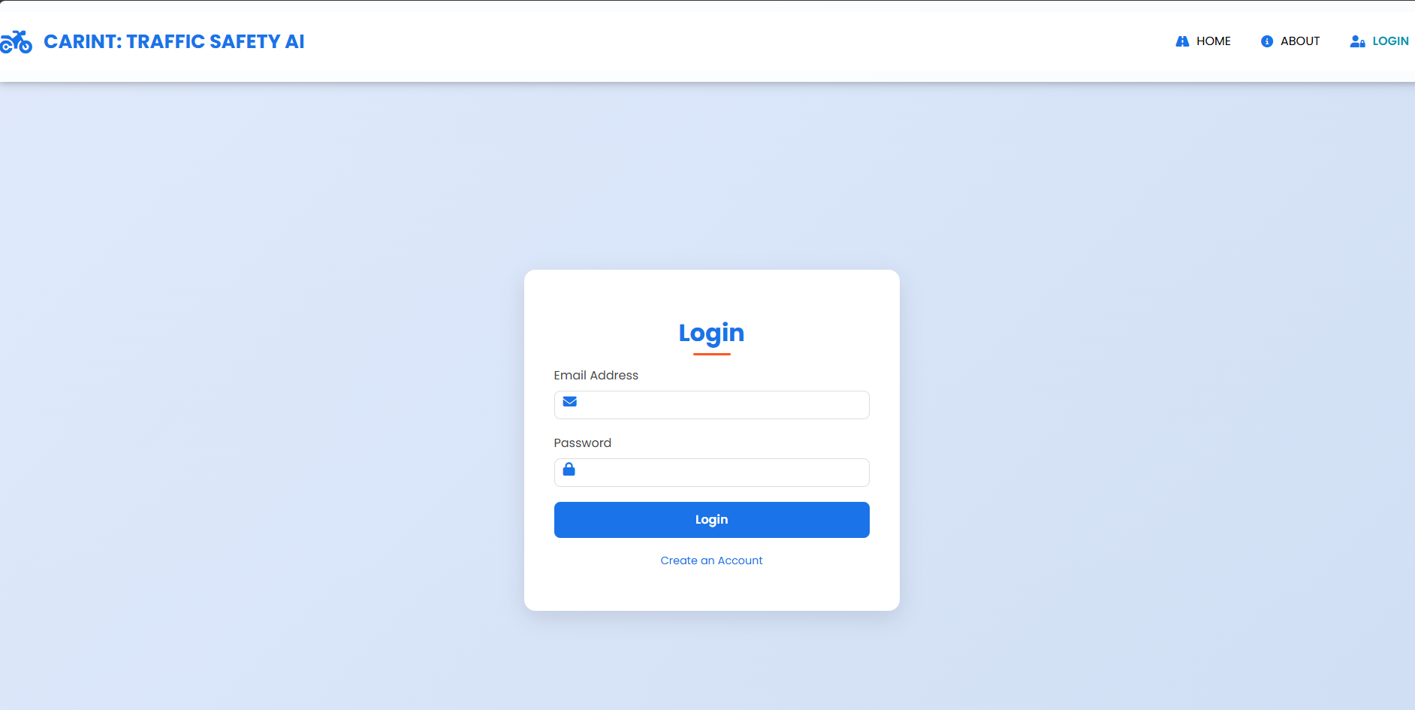
Screen shots
Login page

Slide 35
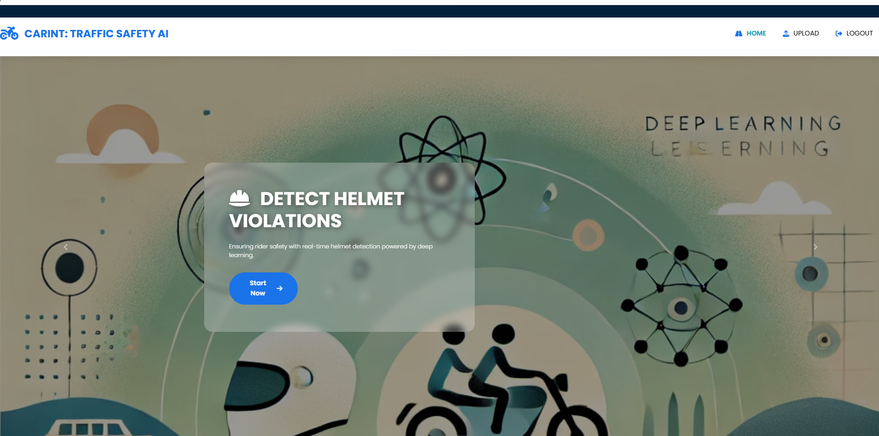
Screen shots
Home Page:

Slide 36
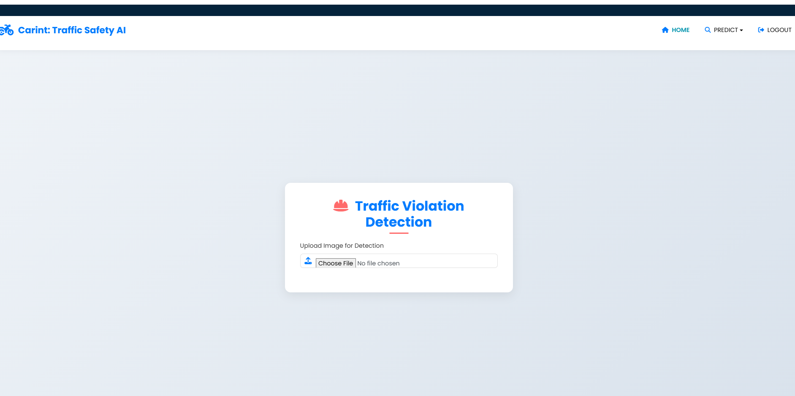
Screen shots
Prediction page

Slide 37
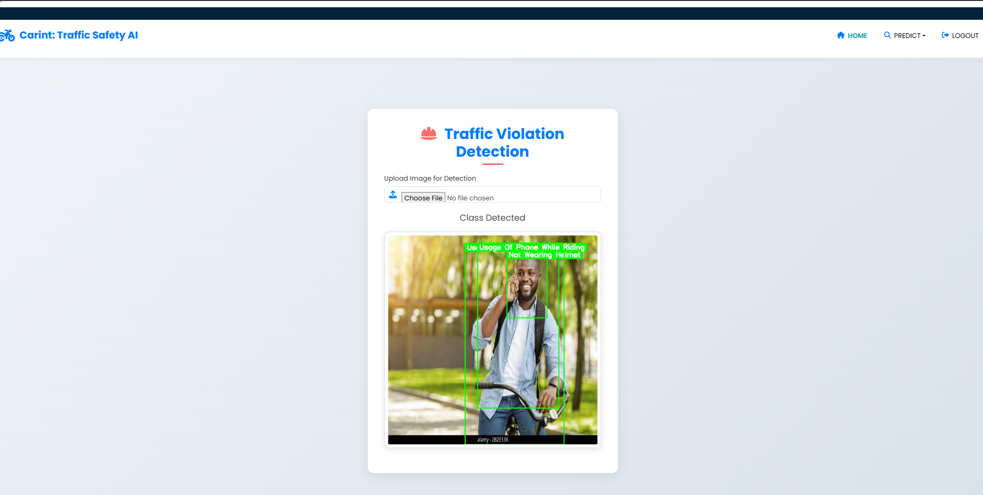
Screen shots
Result page

Slide 38
Conclusion
The proposed traffic violation detection system using YOLOv8 and YOLOv11 offers a transformative approach to improving road safety and enhancing traffic law enforcement. By utilizing advanced deep learning models, the system efficiently detects violations such as helmet non-compliance, triple riding, phone usage while riding, and wheeling in real-time. The backend, implemented in Python and optimized for processing power, ensures seamless video feed analysis, while the front-end interface, built with Streamlit, provides an intuitive platform for traffic authorities to monitor violations easily. This project addresses the limitations of traditional traffic monitoring systems by offering a scalable, accurate, and real-time solution. The system reduces human error, enhances the efficiency of law enforcement, and provides a reliable tool for ensuring safer roads. By automating the detection of traffic violations, the system promotes timely actions and contributes significantly to road safety.

Slide 39
Future Enhancement
Future improvements for this system could involve extending its detection capabilities to include additional traffic violations and integrating more advanced deep learning models. Incorporating transfer learning and ensemble techniques could further boost accuracy and robustness across various traffic scenarios. The system can be optimized for more efficient real-time processing, allowing it to handle higher video stream resolutions and larger-scale traffic monitoring applications. Additionally, cloud-based solutions could be implemented to enable remote access, integration with IoT systems for smart traffic monitoring, and collaboration with robotic enforcement systems for automated actions. Future development could also focus on enhancing the predictive capabilities of the system, providing insights into potential violations before they occur. The integration of AI-driven predictive analytics could provide traffic authorities with real-time alerts, further improving overall traffic safety. As the system evolves, it can be expanded to monitor other aspects of traffic safety, including vehicle speed and dangerous driving patterns.

Slide 40
References
[1] C. Huang, Q. Liu, and S. Yu, “Regions of interest extraction from color image based on visual saliency,” The Journal of Supercomputing, vol. 58, no. 1, pp. 20–33, 2011.
[2] Chen, X., Ma, H., Wan, J., Li, B., & Xia, T. "Multi-view 3D object detection network for autonomous driving." In Proceedings of the IEEE Conference on Computer Vision and Pattern Recognition (CVPR), pp. 6526–6534, 2017.
[3] Chen, H., & Zhang, Z. "Hybrid neural network based on novel audio feature for vehicle type identification." Sci. Rep., vol. 11, pp. 1–10, 2021.
[4] Feng, T. T., & Ge, H. Y. "Pedestrian detection based on attention mechanism and feature enhancement with SSD." In Proceedings of the International Conference on Communication, Image and Signal Processing (CCISP), pp. 145–148, 2020..
[5] Sarath, S. "Human emotions recognition from thermal images using YOLO algorithm." In Proceedings of the International Conference on Communication and Signal Processing (ICCSP), pp. 1139–1142, 2020. DOI: https://doi.org/10.1109/ICCSP48568.2020.9182148.

Slide 41
References
[6] Ishak, P., et al. "An efficient real-time colonic polyp detection with YOLO algorithms trained by using negative samples and large datasets." Computers in Biology and Medicine, vol. 105031, 2022.
[7] Yizhou, C., et al. "Generative Adversarial Networks in Medical Image augmentation: A review." Computers in Biology and Medicine, vol. 105382, 2022
.
[8] Qiu, G., et al. "Medical image augmentation for lesion detection using a texture-constrained multichannel progressive GAN." Computers in Biology and Medicine, vol. 105444, 2022.
[9] Kyle, M., et al. "A YOLO-based software for automated detection and analysis of rodent behavior in the open field arena." Computers in Biology and Medicine, vol. 104474, 2021.

